Slide 1
2019 Child Hunger Summit: Opportunities and Threats
September 19, 2019
John R. Corlett, President
The Center for Community Solutions

Slide 2
The Center for Community Solutions
Established in 1913, the Center for Community Solutions provides strategic leadership and organizes community resources to improve health, social and economic conditions through applied demographic research, nonpartisan policy analysis and advocacy and communication.

Slide 3
Overview
Trends in childhood food insecurity
Consequences of childhood food insecurity
Direct and indirect strategies for reducing food insecurity
Barriers and threats

Slide 4
What is Food Insecurity?
Food insecurity describes a household’s inability to provide enough food for every person to live an active, healthy life. Food insecurity is one way we measure and assess the risk of hunger. In the United States currently, 1 in 6 children struggle with hunger.

Slide 5
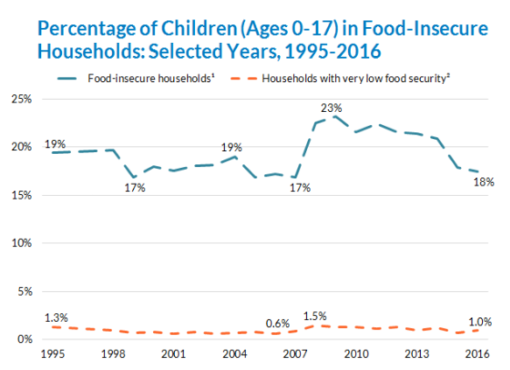
Childhood Food Insecurity Rates Have Been Decreasing
Household food insecurity among children rose from 1999 to 2004, reflecting a slowing economy. In 2005, the rate of household food insecurity among children declined; it remained fairly constant (at 17%) until 2008, when it rose to 23%. Since then, the rate has decreased.
Source: Food Insecurity, Child Trends, September, 2018

Slide 6
A Sample of Food Security Questions Asked of Households with Children
We relied on only a few kinds of low-cost food to feed our children because we were running out of money to buy food.
We couldn’t feed our children a balanced meal, because we couldn’t afford that.
In the last 12 months, did you ever cut the size of any of the children’s meals because there wasn’t enough money for food?
In the last 12 months, did any of the children ever skip a meal because there wasn’t enough money for food?
In the last 12 months, did any of the children ever not eat for a whole day because there wasn’t enough money for food?

Slide 7
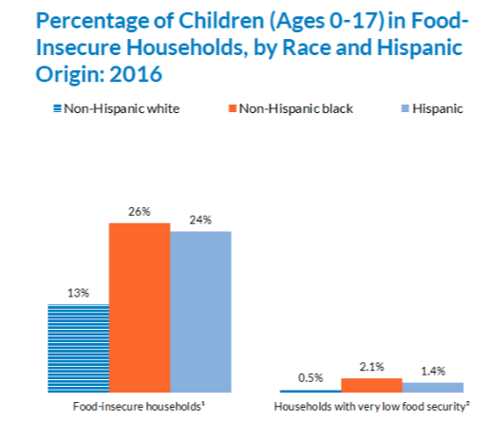
Food Insecurity Rates Remain Higher for Black and Hispanic Children
In 2016, household food insecurity was almost twice as prevalent among children in households headed by non-Hispanic black or Hispanic adults than in those headed by non-Hispanic white adults.
Source: Food Insecurity, Child Trends, September, 2018
Notes:
In 2016, household food insecurity was almost twice as prevalent among children in households headed by non-Hispanic black (26 percent) or Hispanic adults (24 percent) than in those headed by non-Hispanic white adults (13 percent)
The proportion of households in which children had “very low food security” was roughly three to four times as high in non-Hispanic black or Hispanic households as in non-Hispanic white households

Slide 8
Food Insecurity Has Negative Impacts on Children’s Health
Children in food-insecure households had rates of lifetime asthma diagnosis and depressive symptoms that were 19.1% and 27.9% higher,
Children in food-insecure households had rates of foregone medical care that were 179.8% higher, and rates of emergency department use that were 25.9% higher.
A relationship exists between food insecurity and Attention-Deficit Hyperactivity Disorder (ADHD) symptoms such as inattention, hyperactivity, and impulsivity in children.
Sources: Food Insecurity and Child Health, Pediatrics, American Academy of Pediatrics, September, 2019
The Relationship between Food Insecurity and Symptoms of Attention-Deficit Hyperactivity Disorder in Children: A Summary of the Literature, Nutrients, March 2019

Slide 9
Parental Food Insecurity Has Negative Impact on Children & Family Functioning
Parents struggling with food insecurity can experience heightened levels of stress, anxiety, and depression.
Parenting aggravation that coincides with food insecurity is negatively associated with children’s executive functioning.
Supporting food-insecure parents may improve parenting and thus have benefits both for parents and their children.
Source: Parenting Aggravation Associated with Food Insecurity Impacts Children’s Behavior and Development, Center for Poverty Research, University of California, Davis, December 2018

Slide 10
Childhood Food Insecurity in Erie, Huron and Lorain Counties is Higher than Ohio and National Average
Erie County 20.4%
Huron County 21.6%
Lorain County 20.3%
State of Ohio 19.6%
Food insecurity rates in Ohio have been declining since 2015. Half of all food insecure Ohioans live in households that do not qualify for SNAP.
Source: Food Insecurity in the United States, Feeding America, 2017

Slide 11
Important strategies for addressing childhood food insecurity
Direct Programs
Supplemental Nutrition Assistance Program (SNAP).
Women, Infants and Children (WIC) program.
Child and Adult Care Food Program – CACFP;
Summer Food Service Program –SFSP;
National School Lunch Program
Indirect Programs
Childcare Subsidies
Medicaid and Children’s Health Insurance Program
Temporary Assistance for Needy Families (TANF)
Earned Income Tax Credit (both federal and state)
Child Care Tax Credit

Slide 12
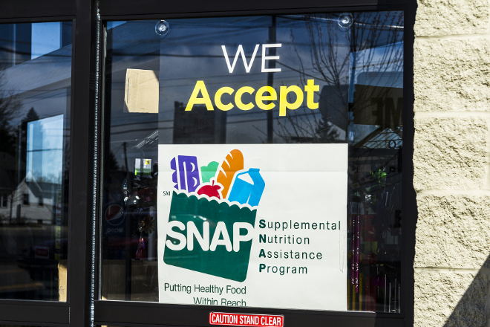
Supplemental Nutrition Assistance Program
SNAP provides electronic voucher payments that can be used at authorized stores to purchase food intended to be taken home and prepared. SNAP is a universal program with no additional targeting besides income and asset criteria. Legal immigrants were barred from the program as part of the Personal Responsibility and Work Opportunity Act of 1996(designed to reform welfare), but the 2002 farm bill restored eligibility for all legal immigrants who are children or disabled.

Slide 13
SNAP and Children
One in 5 SNAP households included a young child (ages 0 – 4).
A third of money spent on SNAP benefits went to families with young children.
Median benefits for households with young children were $12.86 per day.
16% of all households with young children receiving SNAP benefits report no cash income.
Source: Food Support Programs and Their Impact on Young Children, Health Affairs, Culture of Health, March, 2019

Slide 14
Benefits of SNAP
Maternal receipt of SNAP during pregnancy reduces the incidence of low birth-weight by between 5 and 23 percent.
Among adults who grew up in disadvantaged households, access to SNAP in utero and early childhood led to a 16 percentage point decline in the likelihood of being obese as an adult
An 18 percentage point increase in the likelihood of completing high school.
Children on SNAP did better on end-of-grade achievement test scores in math and reading
Source: Long Term Benefits of the Supplemental Nutrition Assistance Program, Office of the President of the United States, December, 1015

Slide 15
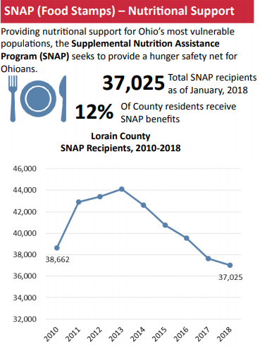
SNAP Participation Rates are Dropping
Notes:
SNAP participation rates are similar to the state rates, participation rate drops in Huron (6%) and Lorain (4%) are less than state declines, while Erie County (11%) is just above

Slide 16
SNAP Participation Rates are Dropping
Recent data from the Children's Defense Fund Ohio shows the largest year-over-year decline in kids registering for food stamps in Ohio in a decade. From 2017 to 2018, about 50,000 Ohio children are estimated to have stopped utilizing SNAP benefits.

Slide 17
SNAP Solution: Support Community Assisters
Assist those without access to computers, the internet and/or unlimited phone minutes.
Provide guidance or application assistance for consumers when county phone lines are jammed and/or the online application is down.
Help individuals with limited English proficiency understand notices sent by the agency (which are only printed in English and Spanish) and interact with the agency.
Engage customers with transportation barriers, limited mobility, disabilities or concerns about the stigma attached to visiting the “welfare office.”
Support document collection and post-application troubleshooting to ensure applicants receive correct eligibility determinations.

Slide 18
SNAP Solution: Create Community Assister Portal
A way to initiate an application on behalf of a client without having to create a customer account.
A mechanism to track submitted applications for client follow up and troubleshooting.
Automated feedback from the eligibility system on the ultimate outcome of submitted application and associated reasons for denial.
A streamlined online application interface that is more consolidated for professional users.
For some, direct access to supervisors and managers at County Job and Family Services to discuss case issues (e.g. wrongful denial) before the issues are escalated to state hearings.

Slide 19
SNAP Solution: Create Community Assister Portal
A way to initiate an application on behalf of a client without having to create a customer account.
A mechanism to track submitted applications for client follow up and troubleshooting.
Automated feedback from the eligibility system on the ultimate outcome of submitted application and associated reasons for denial.
A streamlined online application interface that is more consolidated for professional users.
For some, direct access to supervisors and managers at County Job and Family Services to discuss case issues (e.g. wrongful denial) before the issues are escalated to state hearings.

Slide 20
Women, Infants and Children (WIC)
WIC provides supplemental foods to pregnant and postpartum women, infants, and children under age five who have income levels below 185 percent of poverty (or who can document participation in another means-tested program, such as Medicaid, SNAP, or Temporary Assistance for Needy Families [TANF]) and have been assessed to be at nutritional risk. WIC food benefits are provided in the form of electronic or paper vouchers that can be used to purchase infant formula and other food items such as milk, cereal, and eggs, as specified in the WIC food package.

Slide 21
Health Benefits of WIC
Increases food benefit take-up and reduces food insecurity.
Leads to pregnancy weight gain, higher birth weights, and the probability of breastfeeding initiation at time of hospital discharge.
A USDA study found that for every dollar spent on WIC, there is between $1.77 and $3.13 in Medicaid savings for the infant and mother in the first 60 days after birth.
Increases intakes of three of the four important nutrients for children, including iron, potassium, and fiber.
Prenatal WIC participation is associated with lower infant mortality rates, especially for African-Americans.

Slide 22
Educational Benefits of WIC
Children whose mothers participate in WIC during the prenatal period are less likely to repeat a grade later in childhood compared to their non-WIC siblings.
Maternal participation in WIC has a strong and direct effect on early childhood language development.
Prenatal and early childhood participation in WIC is associated with stronger cognitive development at 2 years old, and better performance on reading assessments in elementary school.
Maternal participation in WIC has a strong and direct effect on early childhood language development.

Slide 23
Barriers to WIC
Common misconceptions about who is or is not eligible (particularly misunderstandings about the eligibility of low-wage working families, immigrant families, and children ages 1 to 5 years old).
Transportation and other costs to reach WIC clinics to apply and continue to receive counseling and benefits.
Language and cultural barriers; In the U.S., more than 1 in 5 families with children under 6 years old speak a language other than English at home.
Dissatisfaction with the contents of the children’s food package.
Difficulty redeeming benefits (limited selection of WIC foods available and embarrassing check-out experiences).

Slide 24
Ohio WIC Coverage for Kids 1-4 Lags

Slide 25
WIC Solutions:
Maximize the value of the children’s WIC food package.
Involve Medicaid managed care organizations in promoting usage of WIC.
Encourage WIC partnerships with SNAP and other public programs.
Less referrals and more “warm handoffs”
Integrate WIC resources and referrals into agencies and programs serving grandparents raising grandchildren and foster parents.
Proactive and targeted outreach to immigrant communities.

Slide 26
Threats to Childhood Food Security
Public Charge Rule will take effect October 15th, unless Congress or the courts act to stop or delay the rule.
The rule redefines what being a public charge means by counting wealth and income as the primary markers of a person’s future contribution, changing who can enter and stay in the country.
Use of SNAP benefits by some lawfully present immigrants could make it less likely they could remain in the U.S.
The rule also does not apply to many categories of immigrants, including refugees, asylees, survivors of domestic violence, and other protected groups.
The rule does not apply to WIC, school meals, and other child and older adult nutrition programs.

Slide 27
Threats to Childhood Food Security
USDA proposing to eliminate states (including Ohio) ability to use broad-based categorical eligibility (BBCE) in SNAP.
USDA estimates the policy will terminate SNAP eligibility for 3.1 million people.
States use BBCE to raise SNAP income eligibility limits somewhat so many low-income working families can continue to reduce the “benefit cliff”.
BBCE also lets states adopt less restrictive asset tests so that families, can have modest savings without losing SNAP.

Slide 28
Threats to Childhood Food Security
Eliminating BBCE will also affect school’s free and low-cost breakfast and lunch programs in the country’s poorest neighborhoods.
Schools where at least 40% of students’ families receive food assistance or other federal welfare benefits can opt to automatically provide all students with free breakfast and lunch as part of the USDA’s Community Eligibility Provision.
But if that number dips below the 40% threshold, federal funds for free breakfast and lunch disappear.
The USDA estimates 500,000 children will lose automatic eligibility for free meals at school as a result of the change, but that does not included entire schools that could be removed from the Community Eligibility Provision.
Deadline for submitting comments is September 23rd.

Slide 29
Reduce Childhood Food Insecurity: Take Action
Submit comments to USDA opposing proposal to end broad-based categorical eligibility for SNAP.
Implement targeted and community based outreach strategies for immigrant, African-American, and Hispanic families.
Support adequate staffing and resources for agencies that determine eligibility for public programs.
Reduce poverty and increase economic activity by increasing percentage of SNAP and WIC eligible persons enrolled.
Push State of Ohio to support role of “community assisters”

Slide 30
Questions
Contact Information
jcorlett@communitysolutions.com
@@CommunitySolsED

